Slide 1
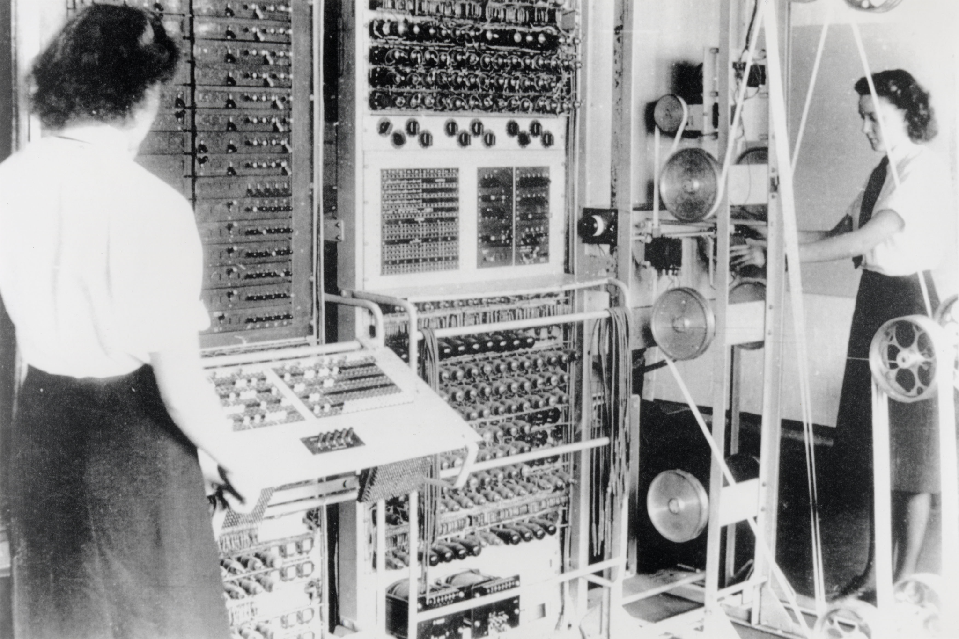

A Brief History of AI
“I propose to consider the question, ‘Can machines think?’ This should begin with definitions of the meaning of the terms ‘machine’ and ‘think’”
- ALAN M TURING (1950)
This lecture traces the remarkable journey of Artificial Intelligence, from its conceptual roots in the 19th century to its transformative impact and future potential in the 21st century.
Notes:
Computing Machinery and Intelligence: https://phil415.pbworks.com/f/TuringComputing.pdf
A Brief History of Time: https://en.wikipedia.org/wiki/A_Brief_History_of_Time

Slide 2
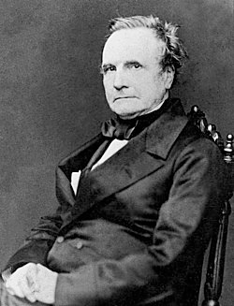
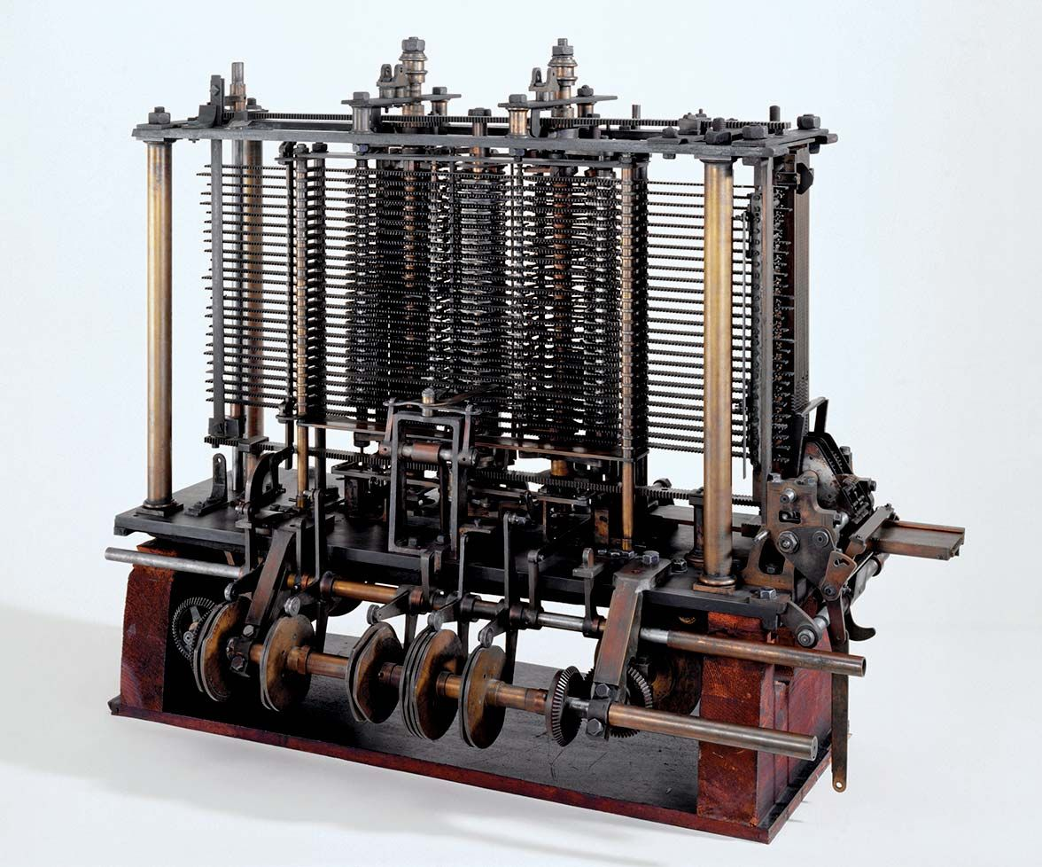
Charles Babbage and The Analytical Engine – 1830’s
English Mathematician and Inventor
Credited for the first Mechanical Computer called the Difference Engine
Proposed the Analytical Engine
Punch Cards for taking input (Computer Program)
Store for storing data (RAM)
Mill for performing computations (CPU)
Output used a printer, curve plotter, and a bell (I/O Devices)
Notes:
Charles Babbage: https://en.wikipedia.org/wiki/Charles_Babbage#Early_life
Difference Engine: https://en.wikipedia.org/wiki/Difference_engine
Ada Lovelace on the Analytical Engine: https://www.fourmilab.ch/babbage/sketch.html
Babbage vs Joseph Clement

Slide 3

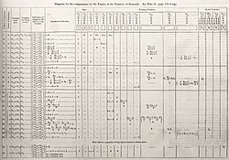
Ada Lovelace the first Computer Programmer– 1840’s
English Mathematician and Writer
First meet Babbage when she was 17
She translated a French article on the Analytical Engine and added extensive notes
Wrote a Program to calculate a sequence of Bernoulli Numbers for the Analytical Engine
“[The Analytical Engine] might act upon other things besides number... the Engine might compose elaborate and scientific pieces of music of any degree of complexity or extent”
“The Analytical Engine has no pretensions whatever to originate anything. It can do whatever we know how to order it to perform. It can follow analysis; but it has no power of anticipating any analytical relations or truths.”
Notes:
Ada Lovelace: https://www.computerhistory.org/babbage/adalovelace/
Ada Lovelace on the Analytical Engine: https://www.fourmilab.ch/babbage/sketch.html
Bernoulli Number: https://en.wikipedia.org/wiki/Bernoulli_number
Note G: https://en.wikipedia.org/wiki/Note_G

Slide 4
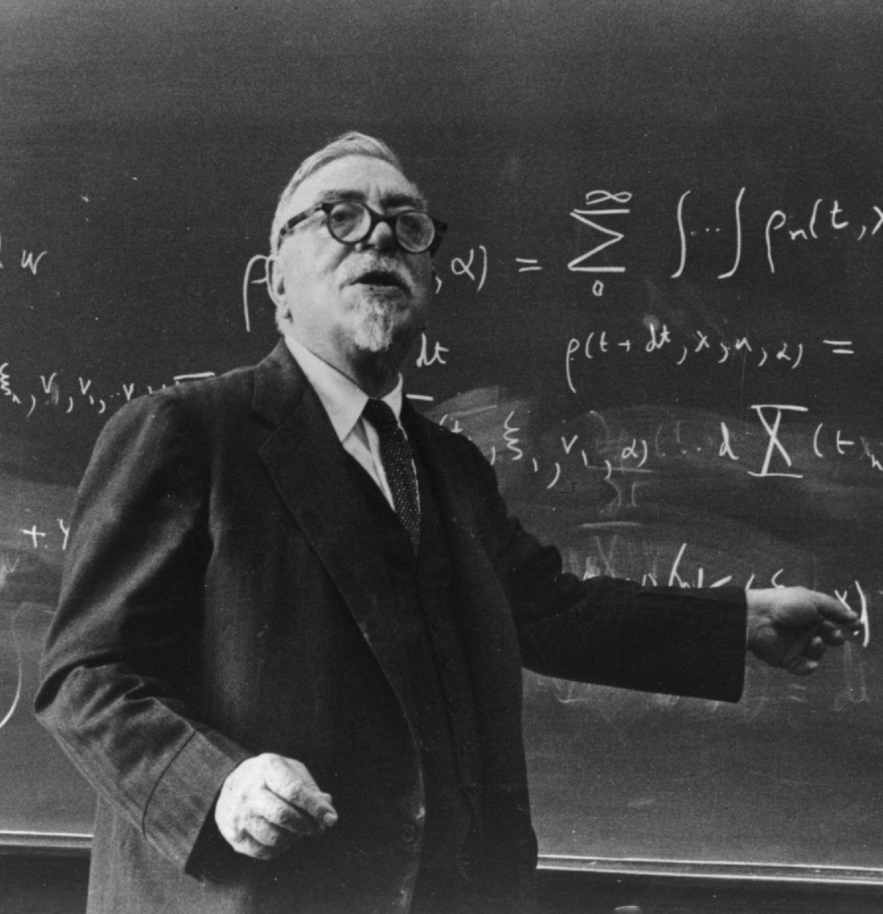
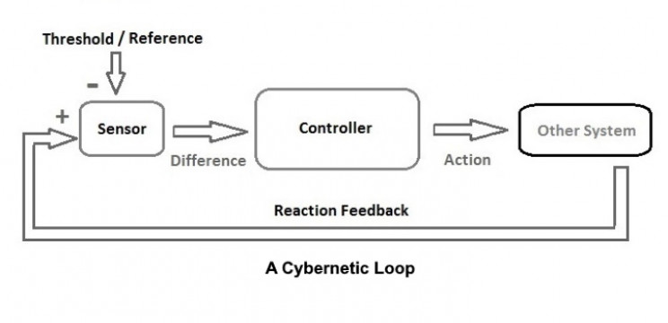
Norbert Wiener and Cybernetics - 1940’s
Mathematician & engineer at MIT
Coined the term Cybernetics in 1948 with his book Cybernetics: Or Control and Communication in the Animal and the Machine
The scientific study of control and communication in animals, humans, and machines.
He presents the idea of a feedback system where a machine can adjust based on the output
Notes:
https://en.wikipedia.org/wiki/Cybernetics:_Or_Control_and_Communication_in_the_Animal_and_the_Machine#Information,_Language,_and_Society
Cybernetics: Or Control and Communication in the Animal and the Machine: https://watermark.silverchair.com/book_9780262355902.pdf?token=AQECAHi208BE49Ooan9kkhW_Ercy7Dm3ZL_9Cf3qfKAc485ysgAAAyowggMmBgkqhkiG9w0BBwagggMXMIIDEwIBADCCAwwGCSqGSIb3DQEHATAeBglghkgBZQMEAS4wEQQMbj5fnvqHyB-cvPLuAgEQgIIC3V7MIa7yEf1X28DebPW0EQVUQiBcbk6b9_4ba2LvQPew7pMoPY3R787dAmo-Ja7Orj3FZTQqE9_W0zOtdg5kQ2sDMMpV5d5tfq3A8cdO-hppCvtTFXRN1BIFNBwZ0h9rwR1pJHIzZvCMZw6EXlabO68Af9UVXjR8pOIU62gPaArsEmnETRVg8eK-hUNS2Cz8-yKUkj6_4Q4t85clPoTk2PzGSjG-y923UKTYN1hd7bbGACfpOCoEP2ChNF7t0A9LhOQzt-RJQp8SPlKD34eortrJATgAXMfdlPkSkypb9rXRmm7yVMMKcbkDjSNqDKDQzVhCfEwHw1mBI5Jrg8B-GbWI71iAWT9O2ttyNTiedlQ_cHytOcpvfRzz152zPIW1Ioe5riA3EMQQ7g3lzVpw0yBrcPVVJn86Vgw2__ypvSPtH8JYeU2rPLwCjXeteQwMq7waC_KhOvGyJ9-BPLBX_umR0yZ9Vymqvxl8n9SRgXQr9G_tpPTbozZoSrtFic-Cl56f9v6auR6PzFhZU6bIfqOp7aOaPP06Fu3kx5AVRpcy7bRJCtpDCOfGoXlbCpdM2sYA24UwnVEILIR9JU1wlqTfKpGdiyQICr5NWq9lCrZ2iZwtba-lMSc406onWM1eSn_HHIK_d9eBANj0B2FYaGfrerx8xrVxyhq8jKBRPjX3I4LPX5-_OkZWB8XATOxn69F3OrB6A4_V0Kh88HB9aFoVr9mNV6wj-zAL3f4JHZO7sZAi09WMo7RjZuVgNwFJC5Ah7VxGjr5U64JwYVF4mPh8B25Em_hkLDBnRi0JckbjAw1v7ZggfGwMy-MA25IQn8Ik2h_LvhLTSE6USBV35Ppz_o_jVq8HYwDgSLMVI6Y5E6Fp8nDM7vfeKJSuxZj2TzMBIbR6oTcnWXxUR2jC0Eu5Kjgr5Y7xyHXPeHQGfrUW0g3wSEElHCL3zIQLMaUrkNgyj4GTvPwWma0RMSg

Slide 5
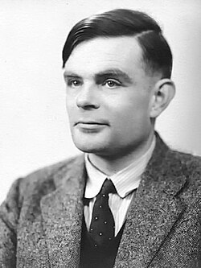
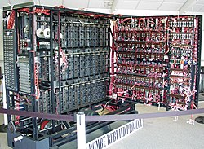
Alan Turing and the Imitation Game – 1950’s
English Mathematician and Computer Scientist
Created a machine to break the German Enigma code during WWII
“A variant of Lady Lovelace's objection states that a machine can ‘never do anything really new.’ … A better variant of the objection says that a machine can never ‘take us by surprise.’ This statement is a more direct challenge and can be met directly. Machines take me by surprise with great frequency.”
Notes:
Computing Machinery and Intelligence: https://phil415.pbworks.com/f/TuringComputing.pdf
The Imitation Game: https://en.wikipedia.org/wiki/The_Imitation_Game
Enigma Cipher Machine: https://en.wikipedia.org/wiki/Cryptanalysis_of_the_Enigma

Slide 6

Alan Turing and the Imitation Game – 1950’s
“The new form of the problem can be described in terms of a game which we call the 'imitation game.’ It is played with three people, a man (A), a woman (B), and an interrogator (C) who may be of either sex. The interrogator stays in a room apart front the other two. The object of the game for the interrogator is to determine which of the other two is the man and which is the woman. He knows them by labels X and Y, and at the end of the game he says either "X is A and Y is B" or "X is B and Y is A. … We now ask the question, ‘What will happen when a machine takes the part of A in this game?’”
Notes:
Split the class into groups of 3 each group will have a:
Interrogator – Creates a list of 5 questions he/she wants to ask the others
Human – Answers the questions without the use of AI
Chatbot – Uses a LLM to answer the questions (ChatGPT, Gemini, Copilot, Perplexity, MetaAI, Deepseek, Claude each group will be assigned an AI model)
The Interrogator will email the other two participants the questions. Each participant will respond to the questions. The groups are responsible for creating a 2 slides that has the questions and the two sets of answers and email them to me by XXXXX. I will take these slides and next class we will see if we can Identify the human and the AI.

Slide 7
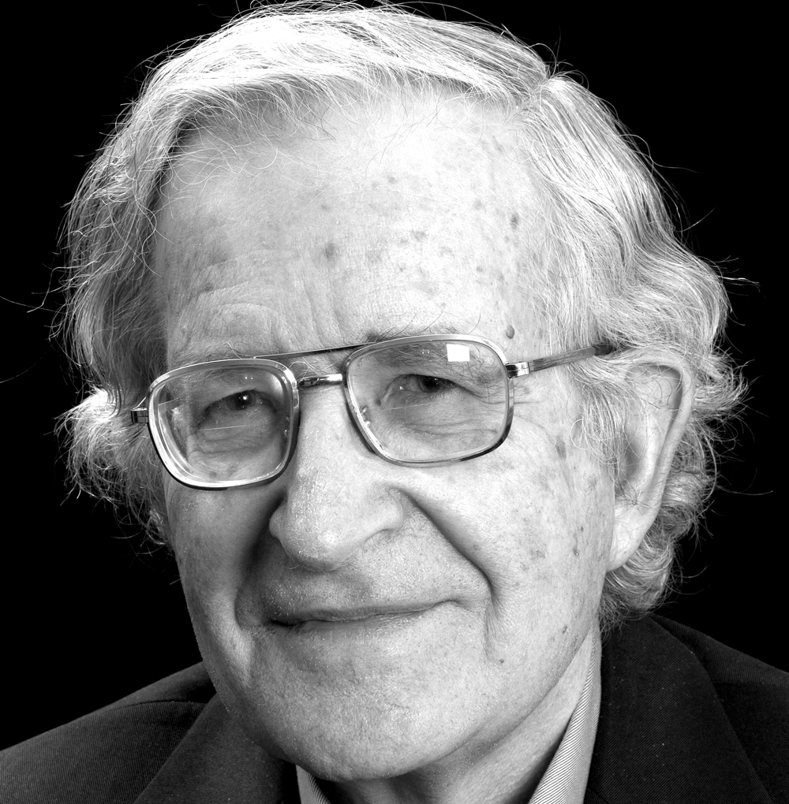
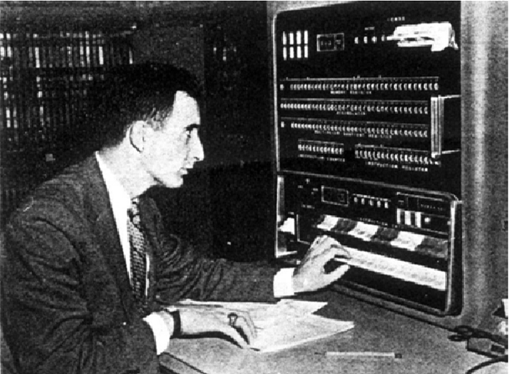
The Birth of Machine Translation - 1950’s
1955 Georgetown-IBM Experiment: First major MT demo translating 60 Russian sentences into English using a small vocabulary and hand-crafted rule
Noam Chomsky (1957): Introduced generative grammar, focusing on deep structure and universal rules of language.
Concern: Chomsky argued that language cannot be learned purely from statistical patterns; rules and structure were essential.
This influenced early MT to favor rule-based approaches over data-driven methods.
Notes:
Mechanical Translation: New Challenge to Communication: https://www.science.org/doi/10.1126/science.122.3173.745
https://www.dataversity.net/a-brief-history-of-natural-language-processing-nlp/
https://doubleoperative.com/wp-content/uploads/2009/12/chomsky-syntactic-structures-2ed.pdf
https://www.historyofinformation.com/detail.php?id=666
Split apart

Slide 8
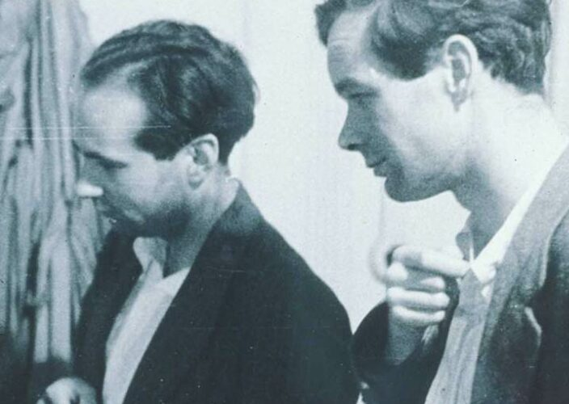
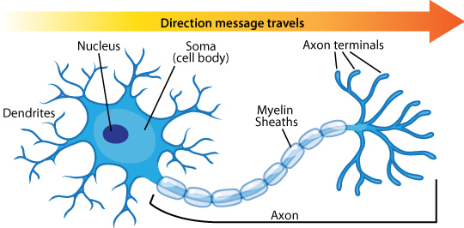
Human Neuron - Hodgkin & Huxley - 1952
Alan Hodgkin – British physiologist.
Andrew Huxley – British physiologist and biophysicist
Awarded the 1963 Nobel Prize in Physiology or Medicine (with John Eccles)
Provided the first quantitative model of how neurons work.
Inspired early artificial neural networks by showing:
Neurons can be modeled mathematically.
Information is transmitted via signals that follow predictable rules.
Notes:
https://en.wikipedia.org/wiki/The_Computer_and_the_Brain
Hodgkin & Huxley Model: https://en.wikipedia.org/wiki/Hodgkin%E2%80%93Huxley_model
Original Hodgkin & Huxley Paper: https://pmc.ncbi.nlm.nih.gov/articles/PMC1392413/

Slide 9
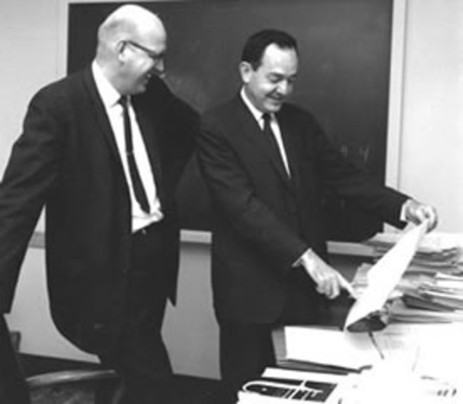
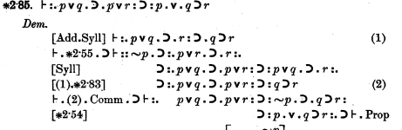
Symbolic AI & Logic Theorist - 1955
Symbolic AI- Approach to AI where knowledge is represented as symbols and manipulated by logical rules.
Logic Theorist
Considered the first AI program.
Designed to prove mathematical theorems from Principia Mathematica (Whitehead & Russell).
Used heuristic search to mimic human problem-solving:
Applied general rules.
Tried promising approaches first (rather than brute force).
Successfully proved 38 of the first 52 theorems, sometimes with more elegant proofs than humans.
Notes:
https://en.wikipedia.org/wiki/Symbolic_artificial_intelligence
LEAN: https://lean-lang.org/
MAPLE:
Mathmatica:
https://lean-lang.org/use-cases/flt/
https://en.wikipedia.org/wiki/Macsyma
https://lesharmoniesdelesprit.wordpress.com/wp-content/uploads/2015/11/whiteheadrussell-principiamathematicavolumei.pdf Page 153

Slide 10

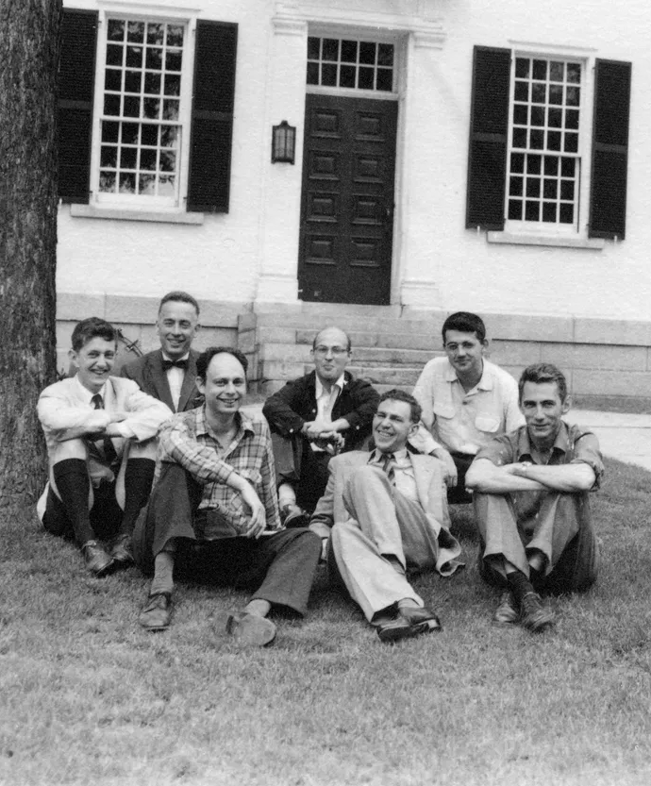
The Dartmouth Workshop– 1956
A 2 month 10 man study on Artificial Intelligence carried out in the summer of 1956 at Dartmouth
“every aspect of learning or any other feature of intelligence can in principle be so precisely described that a machine can be made to simulate it” - McCarthy et al.
How Can a Computer be Programmed to Use Language
Neuron Nets
Self Improvement
Randomness and Creativity
Notes:
The Orginal Proposal for the Confrence - http://www-formal.stanford.edu/jmc/history/dartmouth.pdf?ref=cantorsparadise.org
https://www.cantorsparadise.org/the-birthplace-of-ai-9ab7d4e5fb00/
https://spectrum.ieee.org/dartmouth-ai-workshop
https://home.dartmouth.edu/about/artificial-intelligence-ai-coined-dartmouth
https://en.wikipedia.org/wiki/Dartmouth_workshop

Slide 11
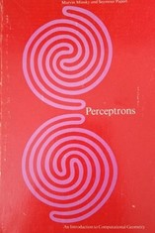
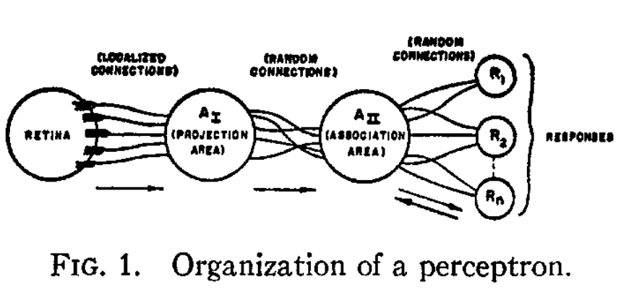
Minsky vs Rosenblatt and The Perceptron – 1960’s
In 1957 Frank Rosenblatt proposes the Perceptron based off a human neuron. It was to be made of 3 parts:
A set of sensory units which receive optical input
A set of association units, each of which fire based on input from multiple sensory units
A set of response units, which fire based on input from multiple association units
Picture of a Perceptron
Notes:
The Perceptron Proposal (1957): https://bpb-us-e2.wpmucdn.com/websites.umass.edu/dist/a/27637/files/2016/03/rosenblatt-1957.pdf
The Perceptron Paper (1958): https://homepages.math.uic.edu/~lreyzin/papers/rosenblatt58.pdf
The Perceptron Book: https://en.wikipedia.org/wiki/Perceptrons_(book)
Mark I Perecptron: https://en.wikipedia.org/wiki/Mark_I_Perceptron
Exercice - Try to linearly separate the XOR problem

Slide 12
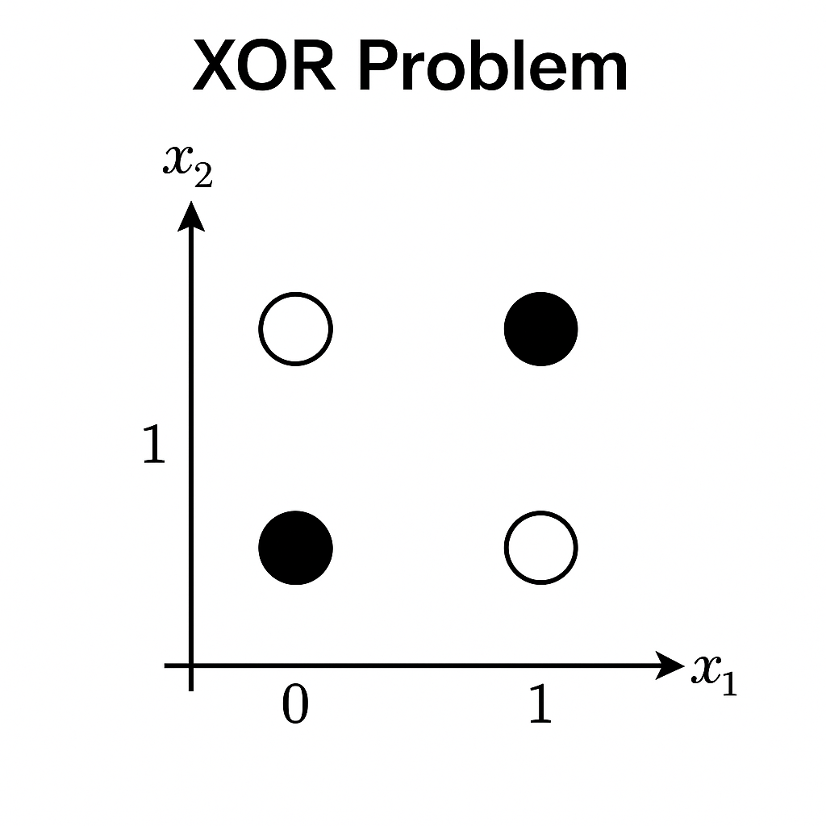
Minsky vs Rosenblatt and The Perceptron – 1960’s
In 1963 Marvin Minsky and Seymour Papert began working on a counter argument to Rosenblatt’s perceptron publishing their book Perceptron in 1969
They showed that the Perpetron could not solve the XOR problem
The XOR Problem
Given a set of four points on the x-y plane classified in two classes (A and B). If the points at (0,1) and (1,0) are in class A and points (0,0) and (1,1) are in class B the question is Can you draw a straight line to seperate the points?
Notes:
The Perceptron Proposal (1957): https://bpb-us-e2.wpmucdn.com/websites.umass.edu/dist/a/27637/files/2016/03/rosenblatt-1957.pdf
The Perceptron Paper (1958): https://homepages.math.uic.edu/~lreyzin/papers/rosenblatt58.pdf
The Perceptron Book: https://en.wikipedia.org/wiki/Perceptrons_(book)
Mark I Perecptron: https://en.wikipedia.org/wiki/Mark_I_Perceptron
Exercice - Try to linearly separate the XOR problem

Slide 13

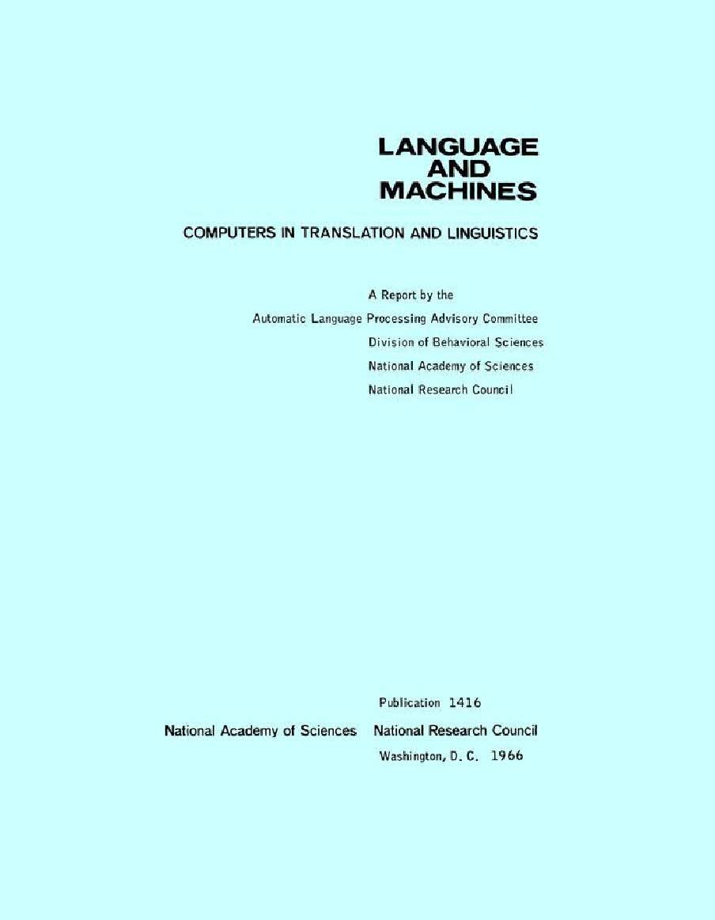
The ALPAC Report - 1960’s
ALPAC (Automatic Language Processing Advisory Committee) Report (1966): U.S. government evaluation of MT progress concluded:
Output was expensive, slow, and inaccurate.
Recommended cutting funding, halting most MT projects.
Impact: Research shifted from fully automatic MT to more linguistics-driven, semi-automatic tools (e.g., computer-assisted translation).
AI language research cooled during the late 1960s due to the report and general disillusionment
Notes:
ALPAC Wikipedia: https://en.wikipedia.org/wiki/ALPAC
Original ALPAC Report: https://nap.nationalacademies.org/read/9547/chapter/1#iii

Slide 14
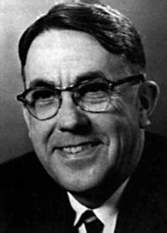
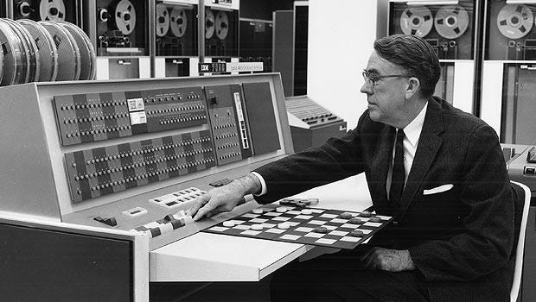
Early AI Applications Checkers – 1962
Arthur Lee Samuel (1901–1990) was an American computer scientist who worked at IBM.
He is often credited with coining the term “machine learning” and was among the first to explore how computers could “learn” from experience rather than being explicitly programmed.
Why Checkers:
The activity must not be deterministic in the practical sense.
A definite goal must exist
The rules of the activity must be definite and they should be known.
There should be a background of knowledge concerning the activity
The activity should be one that is familiar to a substantial body of people so that the behavior of the program can be made understandable to them
Notes:
Some studies in machine learning using the game of checkers: https://ieeexplore.ieee.org/document/5389202 (https://people.csail.mit.edu/brooks/idocs/Samuel.pdf)
Samuel Checkers: http://www.incompleteideas.net/book/ebook/node109.html

Slide 15
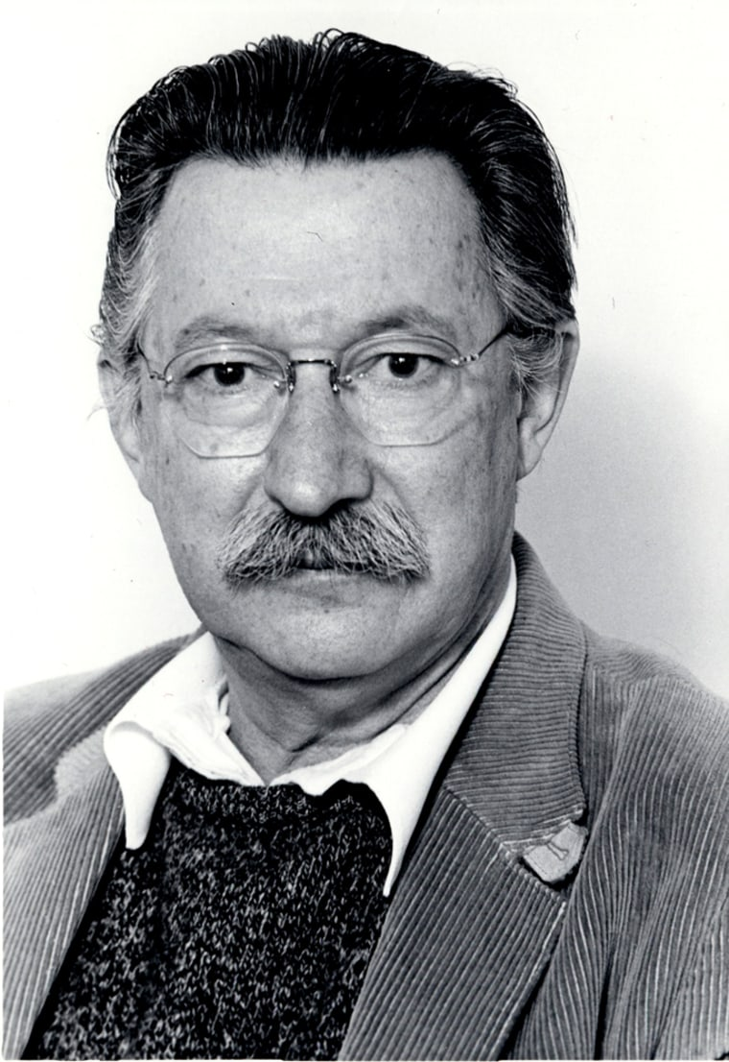
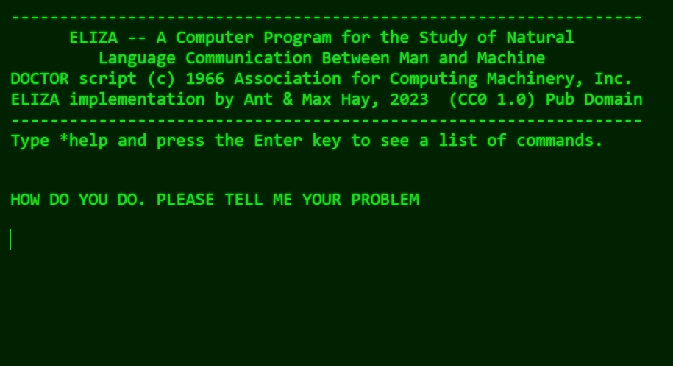
Early AI Applications Chatbots– 1967
“ELIZA is a program which makes certain kinds of natural language conversation between man and computer possible.”
Input sentences are analyzed on the basis of decomposition rules which are triggered by key words appearing in the input text.
Responses are generated by reassembly rules associated with selected decomposition rules.
Why Psychiatry
If, for example, one were to tell a psychiatrist, “I went for a long boat ride,” and he responded, “Tell me about boats,” one would not assume that he knew nothing about boats, but that he had some purpose in so directing the subsequent conversation.
Notes:
Eliza: https://en.wikipedia.org/wiki/ELIZA
History of ELIZA: https://sites.google.com/view/elizagen-org/
Original Paper: https://dl.acm.org/doi/pdf/10.1145/365153.365168
Online version of ELIZA: https://anthay.github.io/eliza.html
Exercise- Talk to ELIZA how does it compare to modern Chat Bots like Copilot or Gemini

Slide 16
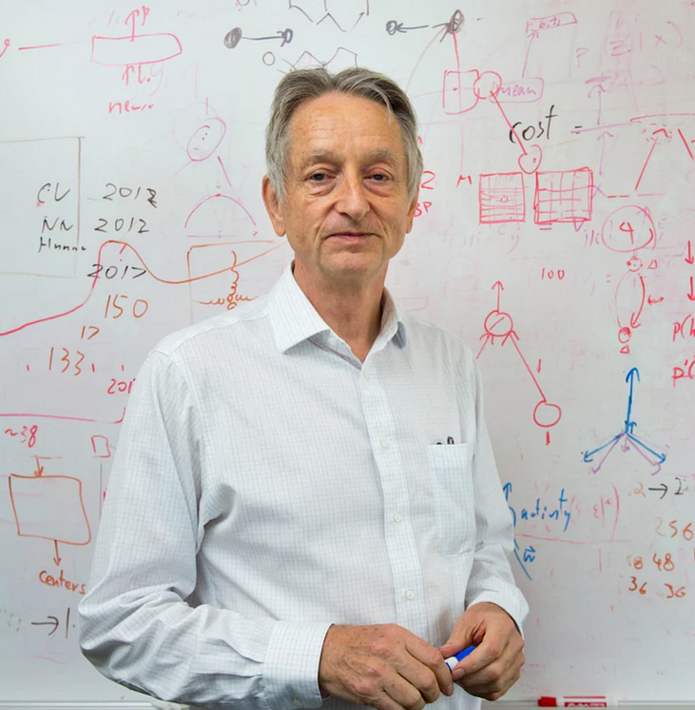
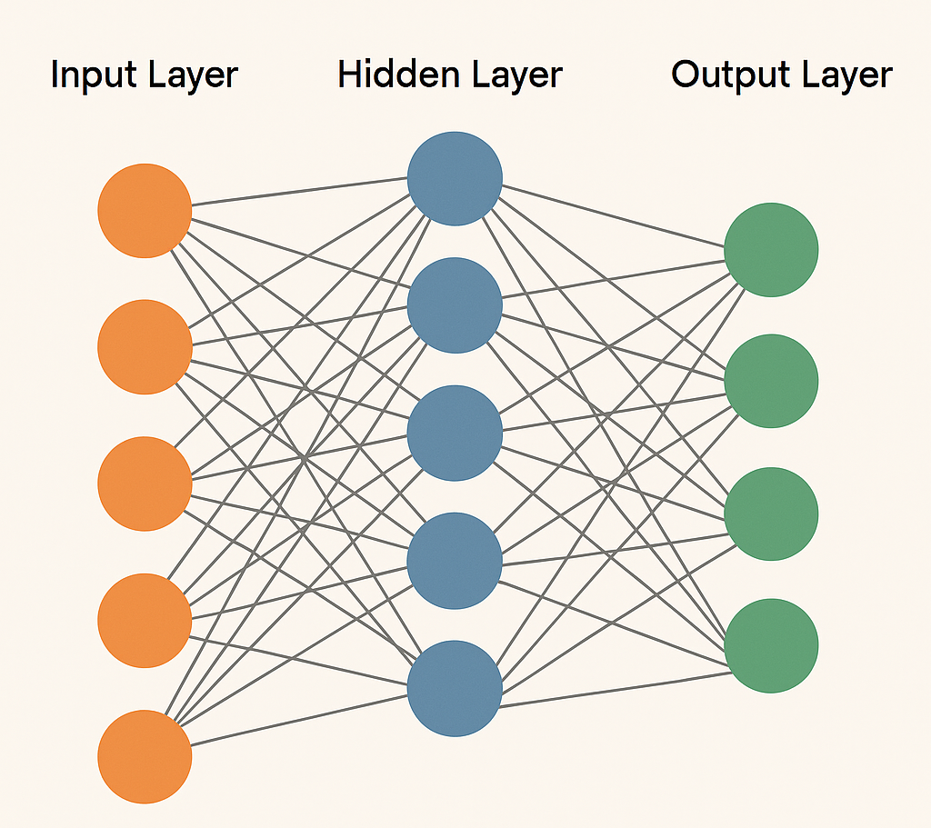
The Rebirth of the Perceptron and Backpropagation– 1980’s
John Hopfield - “Neural networks and physical systems with emergent collective computational abilities”
Rumelhart, Hinton, and Williams - “Learning Representations By-Back Propagating Errors”
“…the procedure discovers weights that turn units in intermediate layers into an “ecology” of useful feature detectors…”
LeNet 1989 - Digit Recognition
Limitations:
Required large datasets
Required large compute power
Hard to train more than 3 hidden layers
Notes:
Learning Representations By-Back Propagating Errors: https://gwern.net/doc/ai/nn/1986-rumelhart-2.pdf
Hopfeild Network: https://pmc.ncbi.nlm.nih.gov/articles/PMC346238/

Slide 17

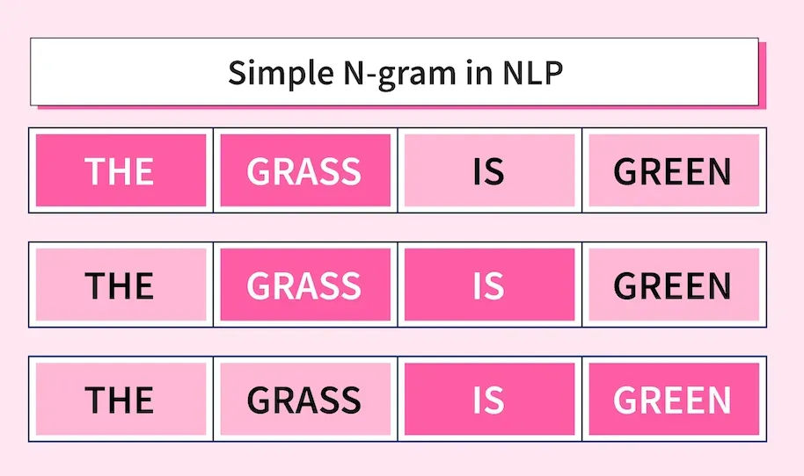
The Rise of Statistical Models – 1990’s
Shift from Rules to Data
Hand-crafted linguistic rules gave way to probabilistic models.
Statistical Machine Translation (SMT)
IBM alignment models (1990–1993) pioneered word/phrase mapping.
N-gram Language Models:
Looks at the previous n words to determine the next word
Computer Science is _________
Notes:
IBM Alignment Model: https://en.wikipedia.org/wiki/IBM_alignment_models

Slide 18
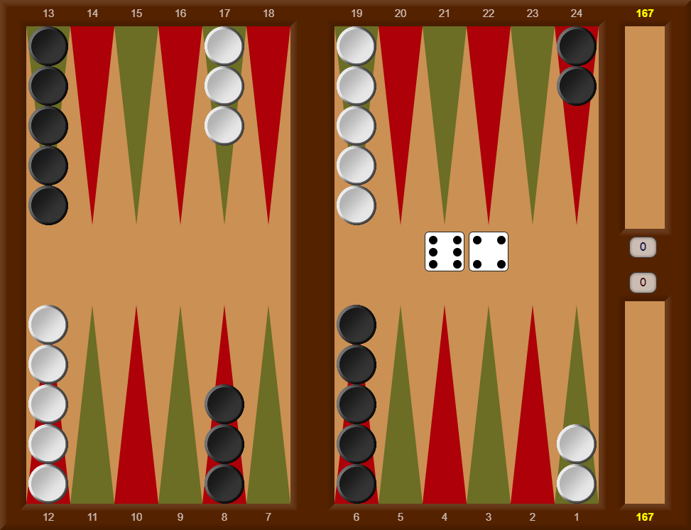
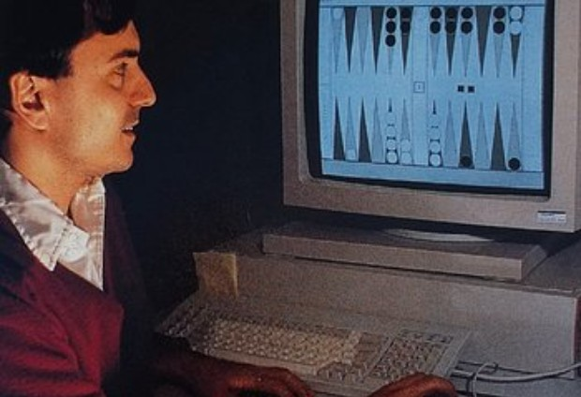
Man vs Machine AI in Games– Backgammon 1992
Created by Gerald Tesauro in 1992
A neural network–based AI designed to play backgammon, a board game with both strategy and chance (due to dice rolls).
Did not start with expert knowledge; it learned entirely from scratch
Used an MLP with one hidden layer
Played millions of games against itself to refine its strategies
It discovered positional play and tactics that rival the best human players and were previously thought to require human intuition
Notes:
TD-Gammon Paper: https://link.springer.com/rwe/10.1007/978-0-387-30164-8_813

Slide 19
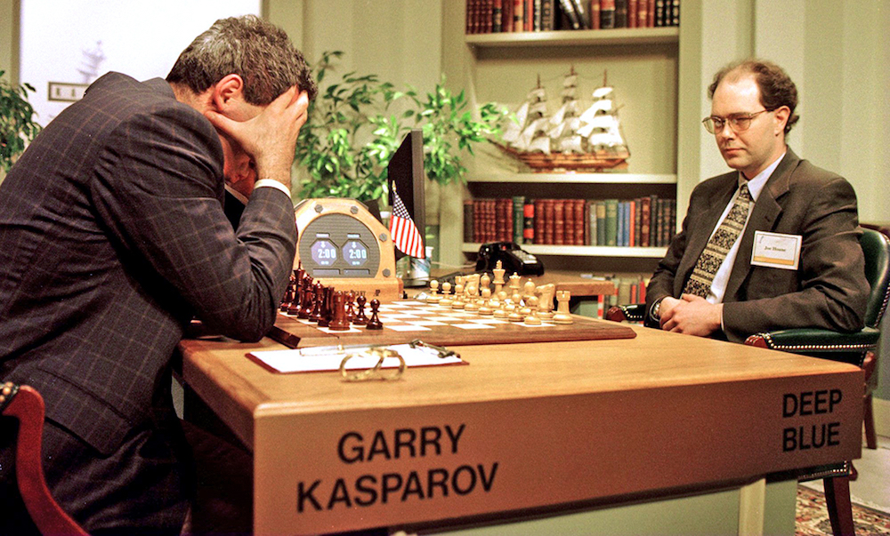
Man vs Machine AI in Games– Chess 1997
“I could feel—I could smell—a new kind of intelligence across the table.” - Garry Kasparov
A chess-playing supercomputer built by IBM.
First computer to defeat a world champion in a full match under tournament conditions
Evaluated 200 million chess positions per second using custom hardware.
Combined brute-force search with human-crafted chess knowledge.
Notes:
Deep Blue vs Kasparov: https://en.wikipedia.org/wiki/Deep_Blue_versus_Garry_Kasparov

Slide 20

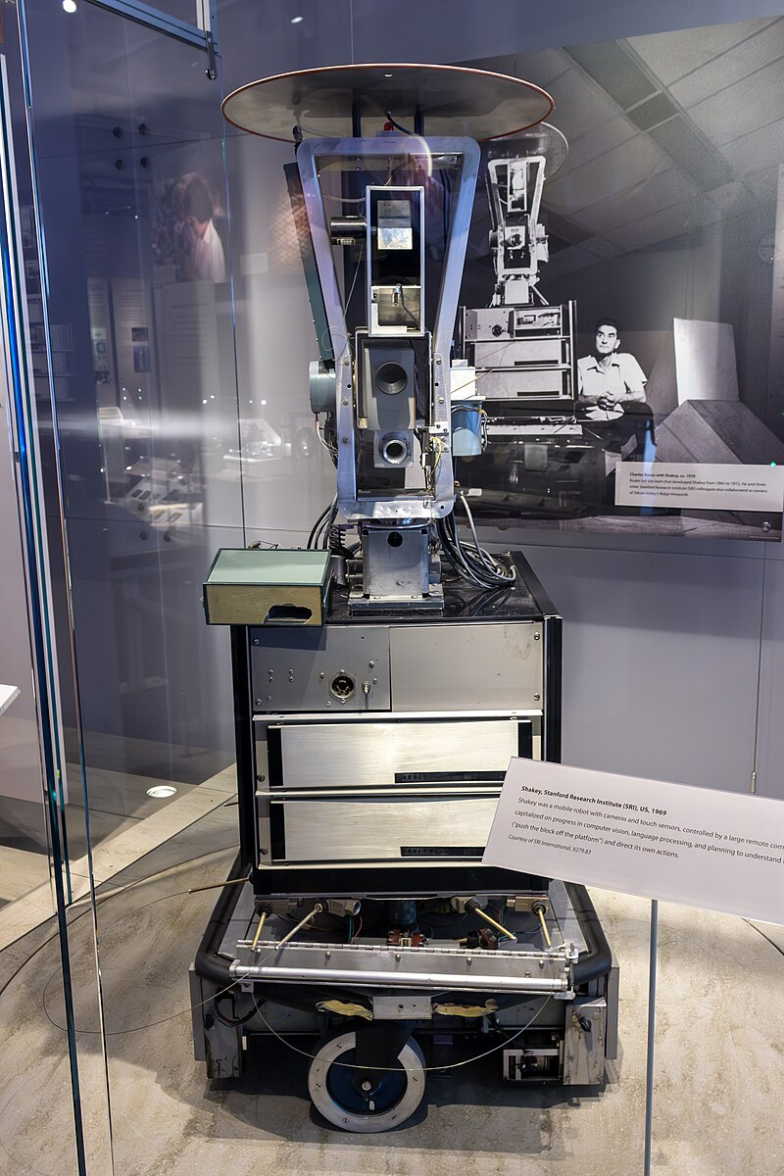
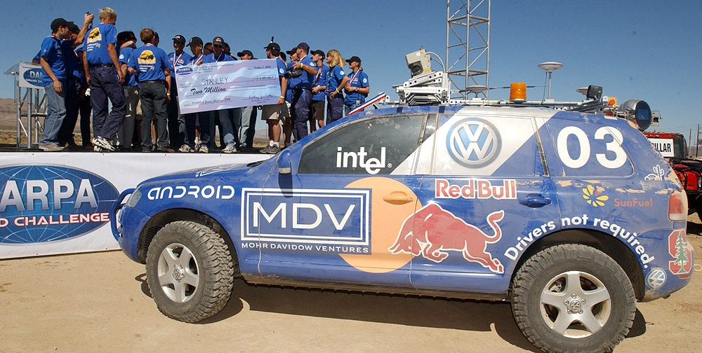
Autonomous Robots and Vehicles
Shakey The Robot - The first general-purpose mobile robot able to reason about its own actions. (1966)
Stanley - Autonomous car which won the 2005 DARPA Grand Challenge (2005)
“A Miami jury decided that Elon Musk's car company Tesla was partly responsible for a deadly crash in Florida involving its Autopilot driver assist technology and must pay the victims more than $240 million in damages” -NPR (August 2 2025)
Notes:
Tesla Self Driving Miami Lawsuit: https://www.npr.org/2025/08/02/nx-s1-5490930/tesla-autopilot-crash-jury-240-million-florida#:~:text=MIAMI%20%E2%80%94%20A%20Miami%20jury%20decided,than%20%24240%20million%20in%20damages.
Waymo in Miami: https://www.miamiherald.com/news/local/community/miami-dade/article297065439.html
https://en.wikipedia.org/wiki/Shakey_the_robot
https://en.wikipedia.org/wiki/Stanley_(vehicle)

Slide 21


Natural Language Processing in the Age of the Internet - 2000’s
Statistical Machine Translation Goes Global
2006: Google Translate launched using web-scale Statistical MT.
Data-Driven NLP Expands
Internet-scale text fueled probabilistic language models.
Enabled better information retrieval, search, and question answering.
Voice Assistants Enter the Mainstream
2011: Apple Siri combined speech recognition + NLP.
Marked the shift from text-based MT to interactive, conversational AI.
Notes:
Deep Blue vs Kasparov: https://en.wikipedia.org/wiki/Deep_Blue_versus_Garry_Kasparov

Slide 22

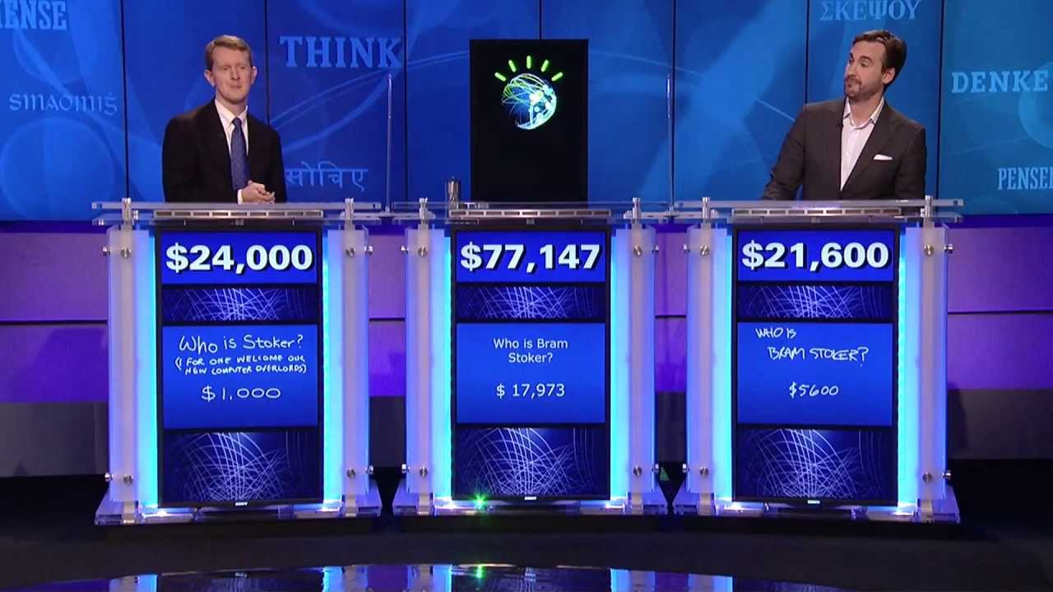
Man vs Machine AI in Games– Jeopardy 2011
“Quiz show contestant’ may be the first job made redundant by Watson, but I’m sure it won’t be the last.” - Ken Jennings Jeopardy Contestant
Named after IBM’s first CEO, Thomas J. Watson Sr., Watson is a question-answering computer system developed by an IBM research team
Unlike search engines, which can parse basic keywords and return a list of related documents that may or may not be relevant, Watson can understand questions posed in natural language and return answers that directly answer the question.
Notes:
IBM Watson: https://www.ibm.com/history/watson-jeopardy
IBM Video on Watson: https://www.youtube.com/watch?v=P18EdAKuC1U

Slide 23

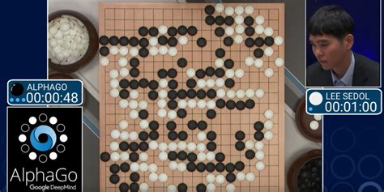
Man vs Machine AI in Games– Go 2016
“I feel like his moves were from an alien intelligence.” - Lee Sedol
Go is an ancient Chinese board game with simple rules but immense complexity.
The board is 19x19 (vs. chess’s 8x8), and the number of possible positions is estimated at 10¹⁷⁰, vastly more than chess (~10⁴⁷).
In 2016, Google DeepMind’s AlphaGo became the first AI to defeat a professional Go player, Lee Sedol, 4-1
Neural networks trained on millions of human games to predict moves.
Notes:
NYT Article about Go (1997): https://www.nytimes.com/1997/07/29/science/to-test-a-powerful-computer-play-an-ancient-game.html

Slide 24

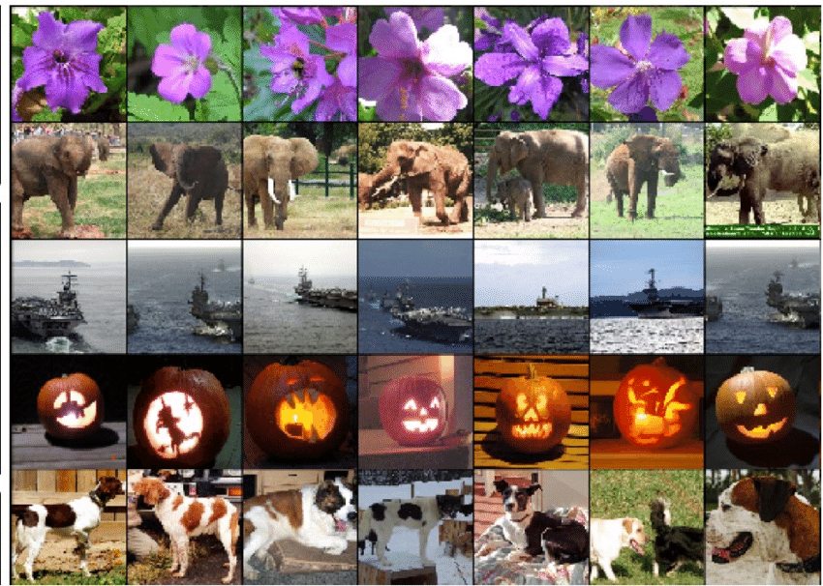
Deep Learning – 2010’s
In 2012 Alex Krizhevsky, Ilya Sutskever, and Geoffrey E. Hinton release AlexNet which was trained to classify images
In 2011 the Top-5 Error rate for the dataset was ~26% AlexNet cut the Top-5 Error Rate to ~18%
Deep, multi-layered CNNs outperformed shallow networks—hierarchical pattern learning at scale
Utilize several new ideas in AI:
GPU Training to speed up training time
ReLu Activation function
Model Normalization (Dropout Layers and Pooling)
Notes:
AlexNet: https://en.wikipedia.org/wiki/AlexNet
ImageNet Classification with Deep Convolutional Neural Networks: https://proceedings.neurips.cc/paper_files/paper/2012/file/c399862d3b9d6b76c8436e924a68c45b-Paper.pdf

Slide 25

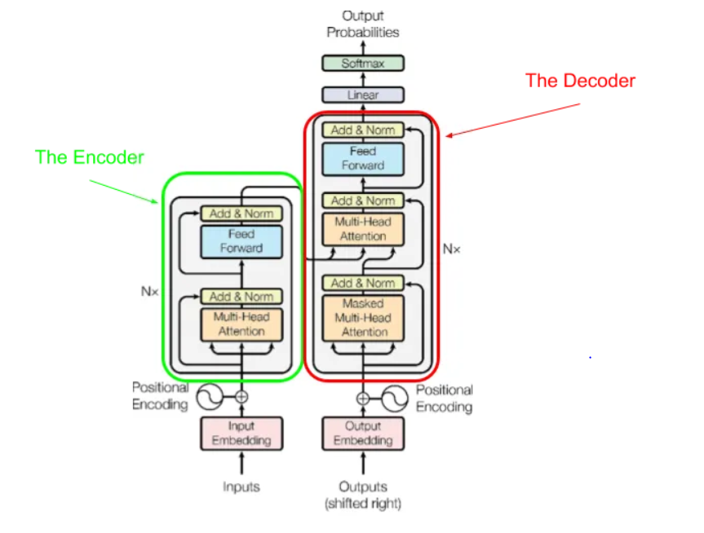
The Transformer – Late 2010’s
A transformer type of AI model that reads and understands language (or images) by focusing on important parts of the input.
It uses something called “attention” to decide what to pay attention to—just like how we focus on key words when reading.
First proposed by a team at Google in a paper called Attention is All You Need
This team was trying to figure out how to make language translation models faster, more accurate, and better at handling long sentences?
Notes:
2017 Attention is all you Need: https://arxiv.org/abs/1706.03762
2018 BERT: https://arxiv.org/abs/1810.04805
2020 VIT: https://arxiv.org/abs/2010.11929

Slide 26







The Large Language Model – 2020’s
A Large Language Model (LLM) is a type of AI trained on huge amounts of text to generate and understand human-like language.
It learns to predict the next word in a sentence, enabling it to answer questions, write stories, translate, and more
GPT-1 (2018)
GPT-2 (2019)
GPT-3 (2020)
GPT-3.5 (2022)
ChatGPT, Copilot, Gemini, Grok, Claude, Llama, Deepseek

Slide 27

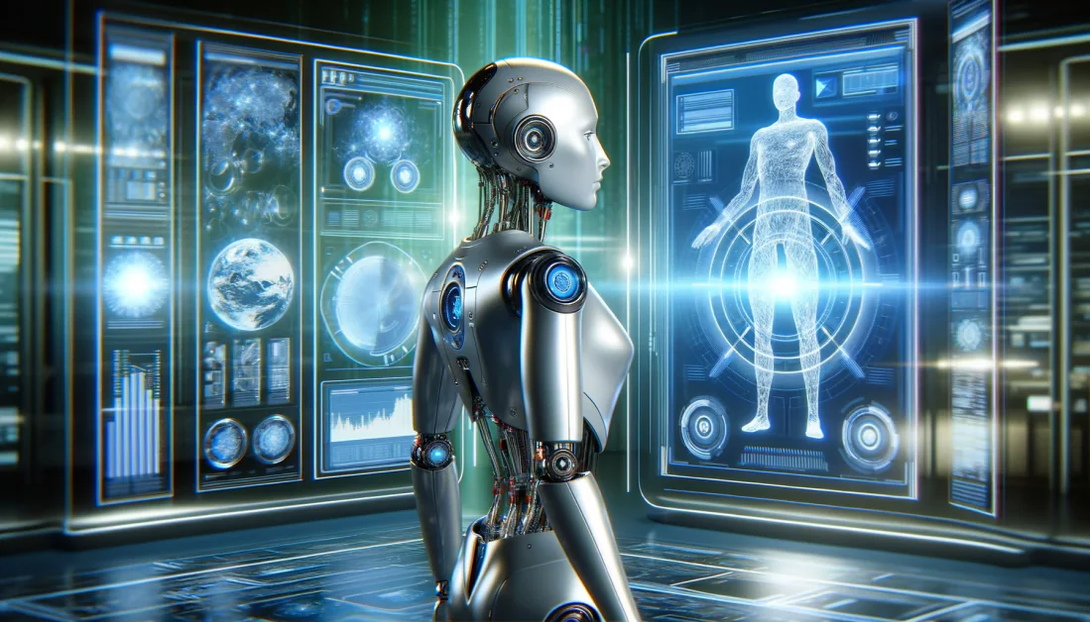
The Future of AI - Road Map
Domain Specific AI
Chain of Thought Reasoning
AI Agents
Cyber Physical AI
Artificial General Intelligence
Notes:
P(doom): https://en.wikipedia.org/wiki/P(doom)
Hinton Interview: https://www.youtube.com/watch?v=qyH3NxFz3Aw
Habassis interview: https://www.youtube.com/watch?v=1XF-NG_35NE

Slide 28
The Future of AI - Pros and Cons
An Optimistic Outlook
A Pessimistic Outlook
Productivity Gains
Transforms Science and Medicine
Faster Drug Development
Cross Field Expertise
Better Medical Care
P (doom) - AI Take Over
“Bad Actors Using AI for Bad Things”
Cyberattacks
Create new weapons
Manipulate Elections
Notes:
P(doom): https://en.wikipedia.org/wiki/P(doom)
Hinton Interview: https://www.youtube.com/watch?v=qyH3NxFz3Aw
Habassis interview: https://www.youtube.com/watch?v=1XF-NG_35NE
Palantir - AI for Military
US - Wants to dominate AI (https://www.wsj.com/tech/ai/trump-china-ai-race-strategy-apec-64487dcc?gaa_at=eafs&gaa_n=ASWzDAigprZBEL70OIYRqi3Jgyx0SrfKZHeru3w0r8pIK8i60N4jhLqPjbq76QL6fJc%3D&gaa_ts=688e575b&gaa_sig=o5hRFzDmfSKzWaPaNadwDYpyP7xOmq7EQtTL-6s9AKAP0XVaLBkqKz3erzVdkZUpVfdGqHYJsyJd4ALxli1ifw%3D%3D)
https://www.whitehouse.gov/wp-content/uploads/2025/07/Americas-AI-Action-Plan.pdf
https://www.whitehouse.gov/articles/2025/07/white-house-unveils-americas-ai-action-plan/
https://www.whitehouse.gov/presidential-actions/2025/07/promoting-the-export-of-the-american-ai-technology-stack/
“The United States must not only lead in developing general-purpose and frontier AI capabilities, but also ensure that American AI technologies, standards, and governance models are adopted worldwide to strengthen relationships with our allies and secure our continued technological dominance.”

Slide 29

Race for AI Dominance - 2025++
“The United States must not only lead in developing general-purpose and frontier AI capabilities, but also ensure that American AI technologies, standards, and governance models are adopted worldwide to strengthen relationships with our allies and secure our continued technological dominance.” - PROMOTING THE EXPORT OF THE AMERICAN AI TECHNOLOGY STACK (2025)
“By 2030, China’s AI theories, technologies, and applications should achieve world-leading levels, making China the world’s primary AI innovation center, achieving visible results in intelligent economy and intelligent society applications, and laying an important foundation for becoming a leading innovation-style nation and an economic power.” - New Generation Artificial Intelligence Development Plan’ (2017)
Notes:
P(doom): https://en.wikipedia.org/wiki/P(doom)
Hinton Interview: https://www.youtube.com/watch?v=qyH3NxFz3Aw
Habassis interview: https://www.youtube.com/watch?v=1XF-NG_35NE
Palantir - AI for Military
US - Wants to dominate AI (https://www.wsj.com/tech/ai/trump-china-ai-race-strategy-apec-64487dcc?gaa_at=eafs&gaa_n=ASWzDAigprZBEL70OIYRqi3Jgyx0SrfKZHeru3w0r8pIK8i60N4jhLqPjbq76QL6fJc%3D&gaa_ts=688e575b&gaa_sig=o5hRFzDmfSKzWaPaNadwDYpyP7xOmq7EQtTL-6s9AKAP0XVaLBkqKz3erzVdkZUpVfdGqHYJsyJd4ALxli1ifw%3D%3D)
https://www.whitehouse.gov/wp-content/uploads/2025/07/Americas-AI-Action-Plan.pdf
https://www.whitehouse.gov/articles/2025/07/white-house-unveils-americas-ai-action-plan/
https://www.whitehouse.gov/presidential-actions/2025/07/promoting-the-export-of-the-american-ai-technology-stack/
“The United States must not only lead in developing general-purpose and frontier AI capabilities, but also ensure that American AI technologies, standards, and governance models are adopted worldwide to strengthen relationships with our allies and secure our continued technological dominance.”

Slide 30
References (in notes)
Notes:
Computing Machinery and Intelligence: https://phil415.pbworks.com/f/TuringComputing.pdf
A Brief History of Time: https://en.wikipedia.org/wiki/A_Brief_History_of_Time
Charles Babbage: https://en.wikipedia.org/wiki/Charles_Babbage#Early_life
Difference Engine: https://en.wikipedia.org/wiki/Difference_engine
Ada Lovelace on the Analytical Engine: https://www.fourmilab.ch/babbage/sketch.html
Ada Lovelace: https://www.computerhistory.org/babbage/adalovelace/
Bernoulli Number: https://en.wikipedia.org/wiki/Bernoulli_number
Note G: https://en.wikipedia.org/wiki/Note_G
Computing Machinery and Intelligence: https://phil415.pbworks.com/f/TuringComputing.pdf
The Imitation Game: https://en.wikipedia.org/wiki/The_Imitation_Game
Enigma Cipher Machine: https://en.wikipedia.org/wiki/Cryptanalysis_of_the_Enigma
The Orginal Proposal for the Confrence - http://www-formal.stanford.edu/jmc/history/dartmouth.pdf?ref=cantorsparadise.org
Dartmouth Conference: https://www.cantorsparadise.org/the-birthplace-of-ai-9ab7d4e5fb00/
Dartmouth Conference IEEE: https://spectrum.ieee.org/dartmouth-ai-workshop
Dartmouth Conference:https://home.dartmouth.edu/about/artificial-intelligence-ai-coined-dartmouth
Dartmouth Conference Wikipedia Page:https://en.wikipedia.org/wiki/Dartmouth_workshop
The Perceptron Proposal (1957): https://bpb-us-e2.wpmucdn.com/websites.umass.edu/dist/a/27637/files/2016/03/rosenblatt-1957.pdf
The Perceptron Paper (1958): https://homepages.math.uic.edu/~lreyzin/papers/rosenblatt58.pdf
The Perceptron Book: https://en.wikipedia.org/wiki/Perceptrons_(book)
Mark I Perecptron: https://en.wikipedia.org/wiki/Mark_I_Perceptron
Some studies in machine learning using the game of checkers: https://ieeexplore.ieee.org/document/5389202 (https://people.csail.mit.edu/brooks/idocs/Samuel.pdf)
Samuel Checkers: http://www.incompleteideas.net/book/ebook/node109.html
Eliza: https://en.wikipedia.org/wiki/ELIZA
History of ELIZA: https://sites.google.com/view/elizagen-org/
Original Paper: https://dl.acm.org/doi/pdf/10.1145/365153.365168
Online version of ELIZA: https://anthay.github.io/eliza.html
Learning Representations By-Back Propagating Errors: https://gwern.net/doc/ai/nn/1986-rumelhart-2.pdf
TD-Gammon Paper: https://link.springer.com/rwe/10.1007/978-0-387-30164-8_813
Deep Blue vs Kasparov: https://en.wikipedia.org/wiki/Deep_Blue_versus_Garry_Kasparov
BM Watson: https://www.ibm.com/history/watson-jeopardy
IBM Video on Watson: https://www.youtube.com/watch?v=P18EdAKuC1U
NYT Article about Go (1997): https://www.nytimes.com/1997/07/29/science/to-test-a-powerful-computer-play-an-ancient-game.html
AlexNet: https://en.wikipedia.org/wiki/AlexNet
ImageNet Classification with Deep Convolutional Neural Networks: https://proceedings.neurips.cc/paper_files/paper/2012/file/c399862d3b9d6b76c8436e924a68c45b-Paper.pdf
2017 Attention is all you Need: https://arxiv.org/abs/1706.03762
2018 BERT: https://arxiv.org/abs/1810.04805
2020 VIT: https://arxiv.org/abs/2010.11929
P(doom): https://en.wikipedia.org/wiki/P(doom)
Hinton Interview: https://www.youtube.com/watch?v=qyH3NxFz3Aw
Habassis interview: https://www.youtube.com/watch?v=1XF-NG_35NE

Slide 31

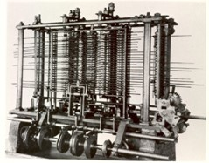
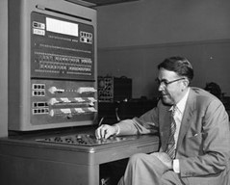
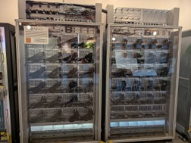
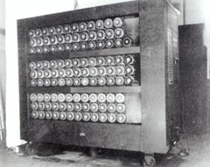
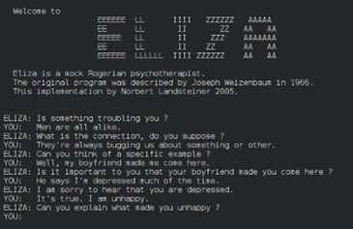
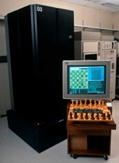
A Brief History of AI
“Genetics researchers have fruit flies. Oncologists have white mice. For pioneering computer scientists studying artificial intelligence, it was games” – IBM The Games that Helped AI Evolve
Huseyin Kocak, University of Miami
Dilip Sarkar, University of Miami
Collin Connors, University of Miami
Disclaimer: Generative AI was used to aid in the design of these slides
Notes:
https://medium.com/design-bootcamp/the-unstoppable-rise-of-spark-as-ais-iconic-symbol-ca663162cccc
Lovelace - “A program can be engineered to do only what we humans know how to do.”
Turing - “I believe that at the end of the century the use of words and general educated opinion will have altered so much that one will be able to speak of machines thinking without expecting to be contradicted.” Computing Machinery and Intelligence
“Within a generation, few compartments of intellect will remain outside the machine’s realm—the problems of creating ‘artificial intelligence’ will be substantially solved.” – Minsky 1967 Computation: Finite and Infinite Machines
“I think we should think of AI as the intellectual equivalent of a backhoe. It will be much better than us at a lot of things.” Geoffrey Hinton

Slide 32
A Brief History of AI
“I propose to consider the question, ‘Can machines think?’ This should begin with definitions of the meaning of the terms ‘machine’ and ‘think’” – Alan M. Turing (1950)
This lecture traces the remarkable journey of Artificial Intelligence, from its conceptual roots in the 19th century to its transformative impact and future potential in the 21st century.
Notes:
Notes on the Script: Flow, End with a Bang

Slide 33
A Brief History of AI
“Genetics researchers have fruit flies. Oncologists have white mice. For pioneering computer scientists studying artificial intelligence, it was games” – IBM The Games that Helped AI Evolve
Huseyin Kocak, University of Miami
Dilip Sarkar, University of Miami
Collin Connors, University of Miami
Disclaimer: Generative AI was used to aid in the design of these slides
Notes:
https://medium.com/design-bootcamp/the-unstoppable-rise-of-spark-as-ais-iconic-symbol-ca663162cccc
Lovelace - “A program can be engineered to do only what we humans know how to do.”
Turing - “I believe that at the end of the century the use of words and general educated opinion will have altered so much that one will be able to speak of machines thinking without expecting to be contradicted.” Computing Machinery and Intelligence
“Within a generation, few compartments of intellect will remain outside the machine’s realm—the problems of creating ‘artificial intelligence’ will be substantially solved.” – Minsky 1967 Computation: Finite and Infinite Machines
“I think we should think of AI as the intellectual equivalent of a backhoe. It will be much better than us at a lot of things.” Geoffrey Hinton

Slide 34
A Brief History of AI
AI for Me: In School, In Work, In Life
“Genetics researchers have fruit flies. Oncologists have white mice. For pioneering computer scientists studying artificial intelligence, it was games” – IBM The Games that Helped AI Evolve
Huseyin Kocak, University of Miami
Dilip Sarkar, University of Miami
Collin Connors, University of Miami
Disclaimer: Generative AI was used to aid in the design of these slides
Notes:
https://medium.com/design-bootcamp/the-unstoppable-rise-of-spark-as-ais-iconic-symbol-ca663162cccc
Lovelace - “A program can be engineered to do only what we humans know how to do.”
Turing - “I believe that at the end of the century the use of words and general educated opinion will have altered so much that one will be able to speak of machines thinking without expecting to be contradicted.” Computing Machinery and Intelligence
“Within a generation, few compartments of intellect will remain outside the machine’s realm—the problems of creating ‘artificial intelligence’ will be substantially solved.” – Minsky 1967 Computation: Finite and Infinite Machines
“I think we should think of AI as the intellectual equivalent of a backhoe. It will be much better than us at a lot of things.” Geoffrey Hinton
“I propose to consider the question, "Can machines think?" This should begin with definitions of the meaning of the terms "machine" and "think."” – Alan Turing

Slide 35
A Brief History of AI
“Genetics researchers have fruit flies. Oncologists have white mice. For pioneering computer scientists studying artificial intelligence, it was games” – IBM The Games that Helped AI Evolve
Huseyin Kocak, University of Miami
Dilip Sarkar, University of Miami
Collin Connors, University of Miami
Disclaimer: Generative AI was used to aid in the design of these slides
Notes:
https://medium.com/design-bootcamp/the-unstoppable-rise-of-spark-as-ais-iconic-symbol-ca663162cccc
Lovelace - “A program can be engineered to do only what we humans know how to do.”
Turing - “I believe that at the end of the century the use of words and general educated opinion will have altered so much that one will be able to speak of machines thinking without expecting to be contradicted.” Computing Machinery and Intelligence
“Within a generation, few compartments of intellect will remain outside the machine’s realm—the problems of creating ‘artificial intelligence’ will be substantially solved.” – Minsky 1967 Computation: Finite and Infinite Machines
“I think we should think of AI as the intellectual equivalent of a backhoe. It will be much better than us at a lot of things.” Geoffrey Hinton

